Slide 1

MACHINE INTELLIGENCE
Dr. N MEHALA
Department of Computer Science and Engineering

Slide 2

MACHINE INTELLIGENCE
Module 4 [Unsupervised Learning]
Dr. N MEHALA
Department of Computer Science and Engineering

Slide 3
MACHINE INTELLIGENCE
Association Rule Mining
Given a set of transactions, find rules that will predict the occurrence of an item based on the occurrences of other items in the transaction
Market-Basket transactions
Example of Association Rules
{Diaper} → {Beer}, {Milk, Bread} → {Eggs,Coke}, {Beer, Bread} → {Milk},
Implication means co-occurrence, not causality!

Slide 4
MACHINE INTELLIGENCE
Association Rule Mining : Definition
Itemset
A collection of one or more items
Example: {Milk, Bread, Diaper}
k-itemset : An itemset that contains k items
Support count (σ)
Frequency of occurrence of an itemset
E.g. σ({Milk, Bread,Diaper}) = 2
Support
Fraction of transactions that contain an itemset
E.g. s({Milk, Bread, Diaper}) = 2/5
Frequent Itemset
An itemset whose support is greater than or equal to a minsup threshold

Slide 5
MACHINE INTELLIGENCE
Association Rule Mining : Definition
Association Rule
An implication expression of the form X → Y, where X and
Y are itemsets
Example: {Milk, Diaper} → {Beer}
Rule Evaluation Metrics
Support (s) : Fraction of transactions that contain both X and Y
Confidence (c) : Measures
how often items in Y appear
in transactions that contain X
Example:

Slide 6
MACHINE INTELLIGENCE
Association Rule Mining Task
Given a set of transactions T, the goal of association rule mining is to find all rules having
support ≥ minsup threshold
confidence ≥ minconf threshold
Brute-force approach:
List all possible association rules
Compute the support and confidence for each rule
Prune rules that fail the minsup and minconf thresholds
⇒ Computationally prohibitive!

Slide 7
MACHINE INTELLIGENCE
Mining Association Rules
Example of Rules:
{Milk,Diaper} → {Beer} (s=0.4, c=0.67) {Milk,Beer} → {Diaper} (s=0.4, c=1.0)
{Diaper,Beer} → {Milk} (s=0.4, c=0.67)
{Beer} → {Milk,Diaper} (s=0.4, c=0.67) {Diaper} → {Milk,Beer} (s=0.4, c=0.5)
{Milk} → {Diaper,Beer} (s=0.4, c=0.5)
Observations:
All the above rules are binary partitions of the same itemset: {Milk, Diaper, Beer}
Rules originating from the same itemset have identical support but can have different confidence
Thus, we may decouple the support and confidence requirements

Slide 8
MACHINE INTELLIGENCE
Mining Association Rules
Two-step approach:
Frequent Itemset Generation
Generate all itemsets whose support ≥ minsup
Rule Generation
Generate high confidence rules from each frequent itemset, where each rule is a binary partitioning of a frequent itemset
Frequent itemset generation is still computationally expensive

Slide 9
MACHINE INTELLIGENCE
Frequent Itemset Generation
Given d items, there are 2^{d} possible candidate itemsets

Slide 10
MACHINE INTELLIGENCE
Frequent Itemset Generation
Brute-force approach:
Each itemset in the lattice is a candidate frequent itemset
Count the support of each candidate by scanning the database
Match each transaction against every candidate
Complexity ~ O(NMw) => Expensive since M = 2^{d} !!!

Slide 11
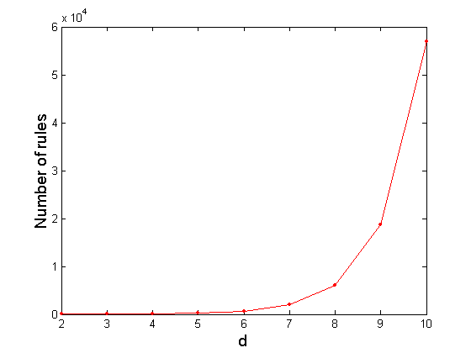
MACHINE INTELLIGENCE
Computational Complexity
Given d unique items:
Total number of itemsets = 2^{d}
Total number of possible association rules:
If d=6, R = 602 rules

Slide 12
MACHINE INTELLIGENCE
Frequent Itemset Generation Strategies
Reduce the number of candidates (M)
Complete search: M=2^{d}
Use pruning techniques to reduce M
Reduce the number of transactions (N)
Reduce size of N as the size of itemset increases
Used by vertical-based mining algorithms
Reduce the number of comparisons (NM)
Use efficient data structures to store the candidates or transactions
No need to match every candidate against every transaction

Slide 13
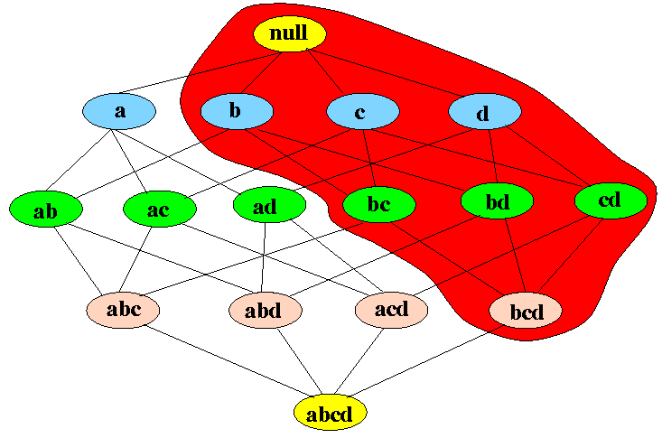
MACHINE INTELLIGENCE
Reducing Number of Candidates
Apriori principle:
If an itemset is frequent, then all of its subsets must also be frequent
Example: if {b,c,d} is frequent, then all subsets of {b,c,d} are also frequent

Slide 14
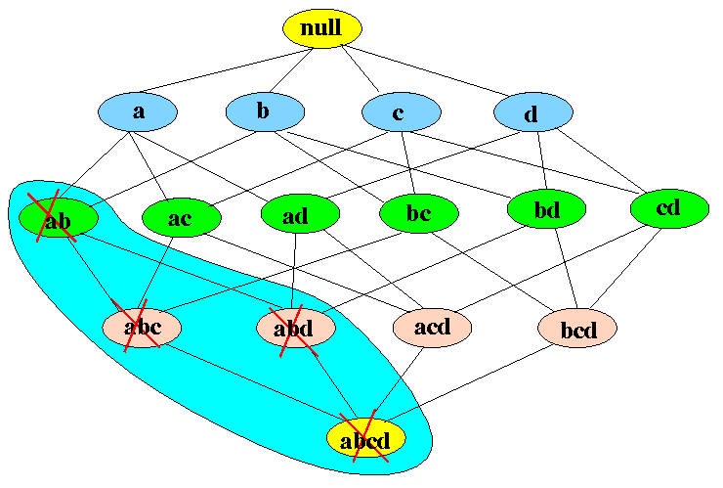
MACHINE INTELLIGENCE
Applying the Apriori Principle to Eliminate Candidate Sets
Converse of the Apriori Principle:
If an itemset x is not frequent then:
all super sets of x are also not frequent
Example:
if {a,b} is infrequent, then all its super sets are also infrequent:

Slide 15
MACHINE INTELLIGENCE
Illustrating Apriori Principle
Found to be Infrequent
Pruned supersets

Slide 16
THANK YOU
Dr. N MEHALA
Department of Computer Science and Engineering
mehala@pes.edu

Slide 17
MACHINE INTELLIGENCE
Dr. N MEHALA
Department of Computer Science and Engineering

Slide 18
MACHINE INTELLIGENCE
Module 4 [Unsupervised Learning]
Dr. N MEHALA
Department of Computer Science and Engineering

Slide 19
MACHINE INTELLIGENCE
Mining Association Rules
Two-step approach:
Frequent Itemset Generation
Generate all itemsets whose support ≥ minsup
Rule Generation
Generate high confidence rules from each frequent itemset, where each rule is a binary partitioning of a frequent itemset

Slide 20
MACHINE INTELLIGENCE
Mining Association Rules
Frequent Itemset Generation
Generate all itemsets whose support ≥ minsup
Apriori Algorithm
FP-Growth Algorithm
H-Mine
CLOSET
CHARM

Slide 21
MACHINE INTELLIGENCE
Applying the Apriori Principle to Eliminate Candidate Sets
Converse of the Apriori Principle:
If an itemset x is not frequent then:
all super sets of x are also not frequent
Example:
if {a,b} is infrequent, then all its super sets are also infrequent:

Slide 22
MACHINE INTELLIGENCE
The Apriori Algorithm - Example
Min support =50%
Database D
L₁
C₁
Scan D
C₂
C₂
L₂
Scan D
{ 1 2 3 5}
{1 2 3}
{1 3 5}
{2 3 5}
C₃
Scan D
L₃

Slide 23
MACHINE INTELLIGENCE
Illustrating Apriori Principle
Items (1-itemsets)
Pairs (2-itemsets)
(No need to generate candidates involving Coke or Eggs)
Minimum Support = 3
Triplets (3-itemsets)
If every subset is considered,
⁶C₁ + ⁶C₂ + ⁶C₃ = 41
With support-based pruning,
6 + 6 + 1 = 13

Slide 24
MACHINE INTELLIGENCE
Apriori Algorithm
Method:
Let k=1
Generate frequent itemsets of length 1
Repeat until no new frequent itemsets are identified
Generate length (k+1) candidate itemsets from length k frequent itemsets
Prune candidate itemsets containing subsets of length k that are infrequent
Count the support of each candidate by scanning the DB
Eliminate candidates that are infrequent, leaving only those that are frequent

Slide 25
THANK YOU
Dr. N MEHALA
Department of Computer Science and Engineering
mehala@pes.edu

Slide 26
MACHINE INTELLIGENCE
Dr. N MEHALA
Department of Computer Science and Engineering

Slide 27
MACHINE INTELLIGENCE
Module 4 [Unsupervised Learning]
Dr. N MEHALA
Department of Computer Science and Engineering

Slide 28
MACHINE INTELLIGENCE
Frequent Itemset Generation Strategies
Reduce the number of candidates (M)
Complete search: M=2^{d}
Use pruning techniques to reduce M
Reduce the number of transactions (N)
Reduce size of N as the size of itemset increases
Used by vertical-based mining algorithms
Reduce the number of comparisons (NM)
Use efficient data structures to store the candidates or transactions
No need to match every candidate against every transaction

Slide 29
MACHINE INTELLIGENCE
Reducing Number of comparisons
Candidate counting:
Scan the database of transactions to determine the support of each candidate itemset
To reduce the number of comparisons, store the candidates in a hash structure
Instead of matching each transaction against every candidate, match it against candidates contained in the hashed buckets

Slide 30
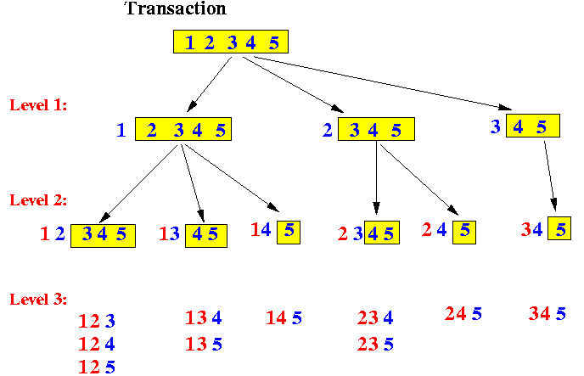
MACHINE INTELLIGENCE
Reducing Number of comparisons
Algorithm to generate k-subsets of a set:

Slide 31
MACHINE INTELLIGENCE
Reducing Number of comparisons
In the Apriori algorithm, the counters for the candidate itemsets are partitioned into different buckets and stored in a hash tree - this speeds up the search for an item set

Slide 32
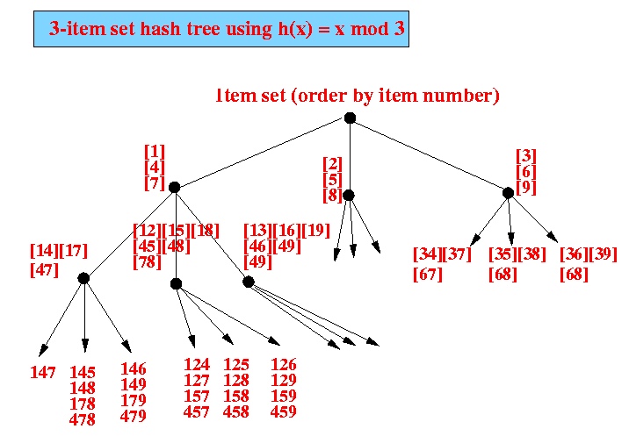
MACHINE INTELLIGENCE
Reducing Number of comparisons
Example: 3-item hash tree for transactions containing items
1, 2, 3, 4, 5, 6, 7, 8, 9
The leaves of the tree contains the counters for the different 3-item item sets
The items in a transaction is first sorted
We then form all 3 item itemsets from the items in the transaction.
The 3-item itemset is hashed using hash(x) = x mod 3 to locate the counter for the itemset

Slide 33
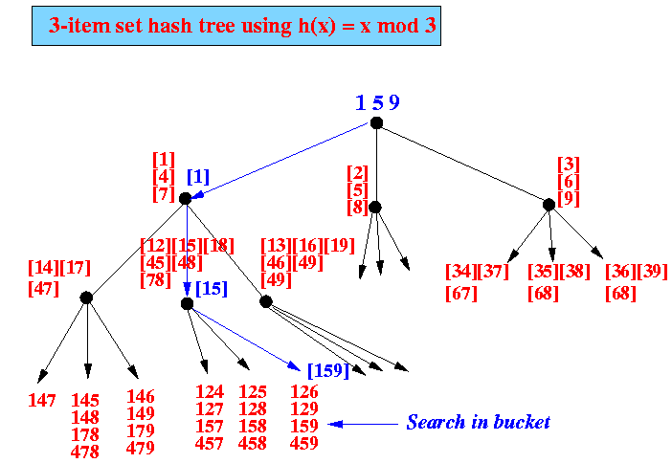
MACHINE INTELLIGENCE
Reducing Number of comparisons
Concrete example:
finding the counter for itemset 1 5 9

Slide 34
MACHINE INTELLIGENCE
Generate Hash Tree
Suppose you have 15 candidate itemsets of length 3:
{1 4 5}, {1 2 4}, {4 5 7}, {1 2 5}, {4 5 8}, {1 5 9}, {1 3 6}, {2 3 4}, {5 6 7}, {3 4 5}, {3 5 6}, {3 5 7}, {6 8 9}, {3 6 7}, {3 6 8}
You need:
Hash function
Max leaf size: max number of itemsets stored in a leaf node (if number of candidate itemsets exceeds max leaf size, split the node)
2 3 4
5 6 7
Hash function
1 4 5
3 4 5
3 5 6
3 5 7
6 8 9
3 6 7
3 6 8
3,6,9
1 3 6
1,4,7
2,5,8
1 2 4
4 5 7
1 2 5
4 5 8
1 5 9

Slide 35
MACHINE INTELLIGENCE
Factors Affecting Complexity
Choice of minimum support threshold
lowering support threshold results in more frequent IS
this may increase number of candidates and max length of frequent itemsets
Dimensionality (number of items) of the data set
more space is needed to store support count of each item
if number of frequent items also increases, both computation and I/O costs may also increase
Size of database
since Apriori makes multiple passes, run time of algorithm may increase with number of transactions
Average transaction width
transaction width increases with denser data sets
This may increase max length of frequent itemsets and traversals of hash tree (number of subsets in a transaction increases with its width)

Slide 36
MACHINE INTELLIGENCE
Compact Representation of Frequent ItemSets
Some itemsets are redundant because they have identical support as their supersets
Number of frequent itemsets
Need a compact representation

Slide 37
MACHINE INTELLIGENCE
Maximal Frequent Itemset
An itemset is maximal frequent if none of its immediate supersets is frequent
Maximal Itemsets
Infrequent Itemsets
Border

Slide 38
MACHINE INTELLIGENCE
Closed ItemSet
An itemset is closed if none of its immediate supersets has the same support as the itemset

Slide 39
MACHINE INTELLIGENCE
Maximal Vs Closed ItemSets
Transaction Ids
Not supported by any transactions

Slide 40
MACHINE INTELLIGENCE
Maximal Vs Closed Frequent ItemSets
Maximal: None of its immediate supersets is frequent
Closed but not maximal
Minimum support = 2
Closed and maximal
# Closed = 9
# Maximal = 4
Closed: None of its immediate
supersets has the same support
as the itemset

Slide 41
MACHINE INTELLIGENCE
Maximal Vs Closed ItemSets

Slide 42
MACHINE INTELLIGENCE
Mining Association Rules
Two-step approach:
Frequent Itemset Generation
Generate all itemsets whose support ≥ minsup
Rule Generation
Generate high confidence rules from each frequent itemset, where each rule is a binary partitioning of a frequent itemset

Slide 43
MACHINE INTELLIGENCE
Mining Association Rules : Rule Generation
Given a frequent itemset L, find all non-empty subsets f ⊂ L such that f → L – f satisfies the minimum confidence requirement
If {A,B,C,D} is a frequent itemset, candidate rules:
ABC →D, ABD →C, ACD →B, BCD →A, A →BCD, B →ACD, C →ABD, D →ABC AB →CD, AC → BD, AD → BC, BC →AD, BD →AC, CD →AB,
If |L| = k, then there are 2^{k} – 2 candidate association rules (ignoring L → ∅ and ∅ → L)

Slide 44
MACHINE INTELLIGENCE
Rule Generation
How to efficiently generate rules from frequent itemsets?
In general, confidence does not have an anti-monotone property
c(ABC →D) can be larger or smaller than c(AB →D)
But confidence of rules generated from the same itemset has an anti-monotone property
e.g., L = {A,B,C,D}: c(ABC → D) ≥ c(AB → CD) ≥ c(A → BCD)
Confidence is anti-monotone w.r.t. number of items on the RHS of the rule

Slide 45
MACHINE INTELLIGENCE
Rule Generation for Apriori Algorithm
Pruned Rules

Slide 46
MACHINE INTELLIGENCE
Summary
Association Rule Mining Task
Frequent Item Set Generation : Apriori Algorithm
Factors Affecting Complexity

Slide 47
MACHINE INTELLIGENCE
Resources
http://www2.ift.ulaval.ca/~chaib/IFT-4102-7025/public_html/Fichiers/Machine_Learning_in_Action.pdf
http://wwwusers.cs.umn.edu/~kumar/dmbook/.
ftp://ftp.aw.com/cseng/authors/tan
http://web.ccsu.edu/datamining/resources.html

Slide 48
THANK YOU
Dr. N MEHALA
Department of Computer Science and Engineering
mehala@pes.edu

